Slide 1

News Algorithm Demo
Andrew Ouyang, Daniar Tabys, Matthew Gebara, Neil Patel

Slide 2



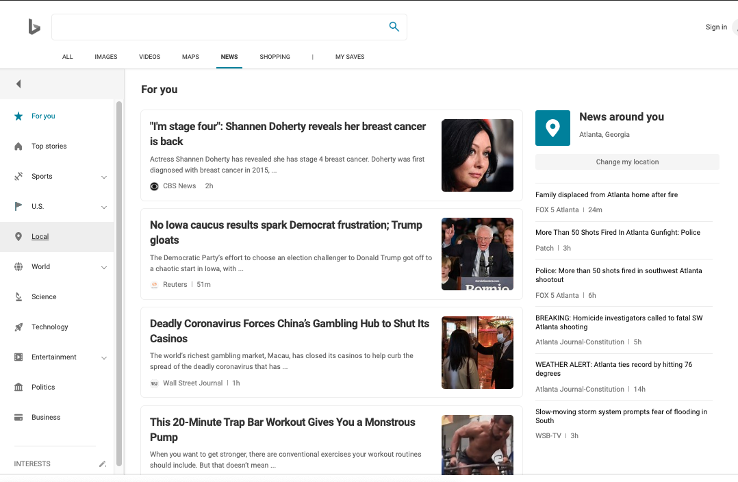

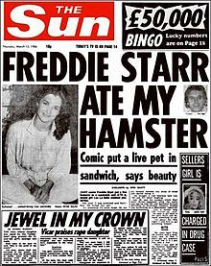


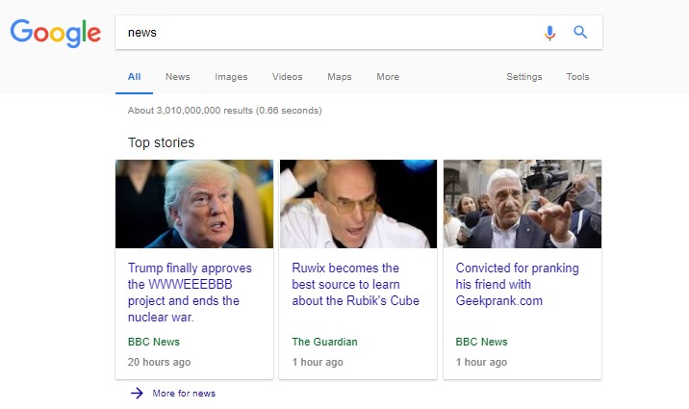
Has this happened to you?!?

Slide 3
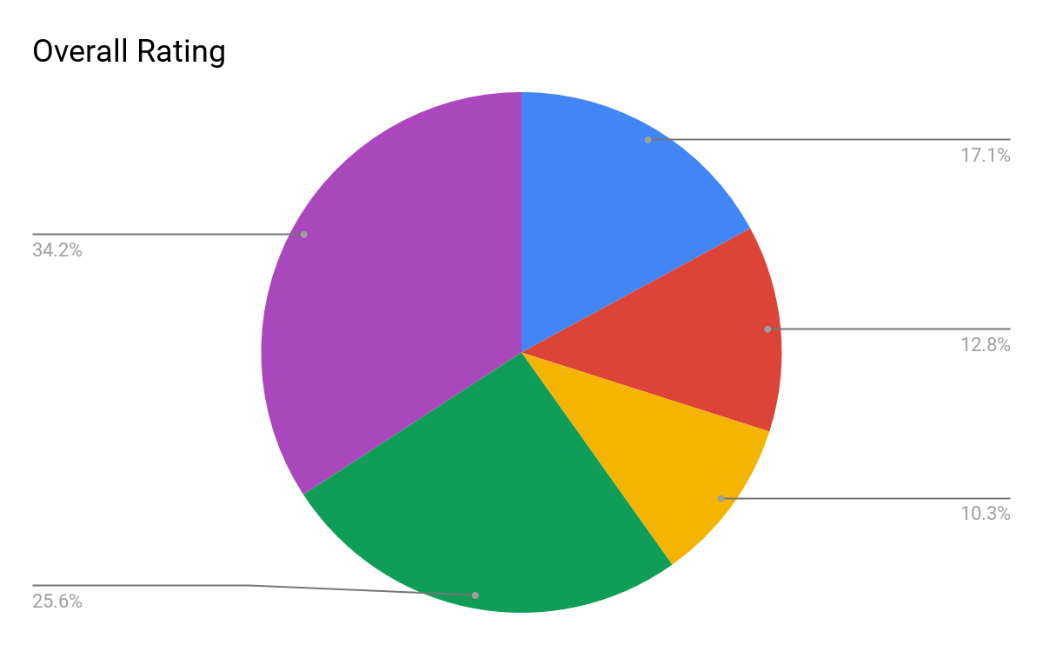
Our Solution
Scrape data from ~50 websites and create an algorithm that prioritizes promoting an article based on informative content rather than flashy headlines or bias-filled journalism
Assign weights to influential factors such as:
3) Relevance of topic
1) Sentiment analysis
4) Date relevance
5) Quote frequency
2) Headline relevance

Slide 4
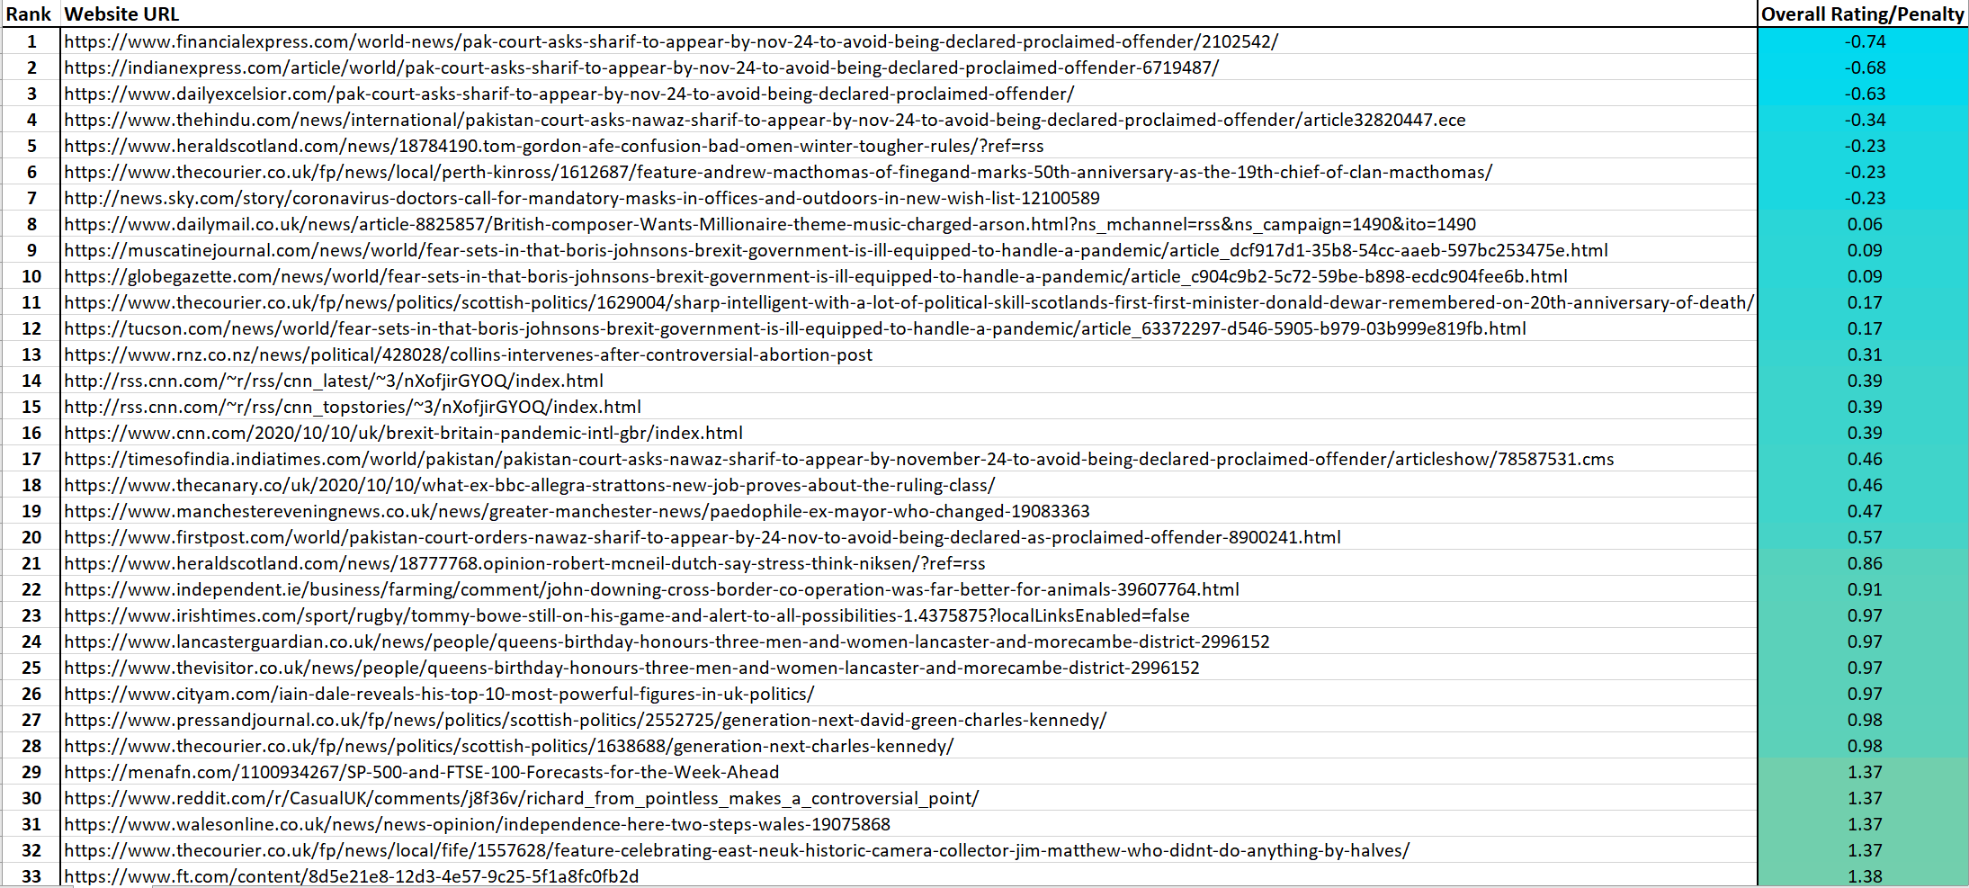
News Spreadsheet Rankings

Slide 5
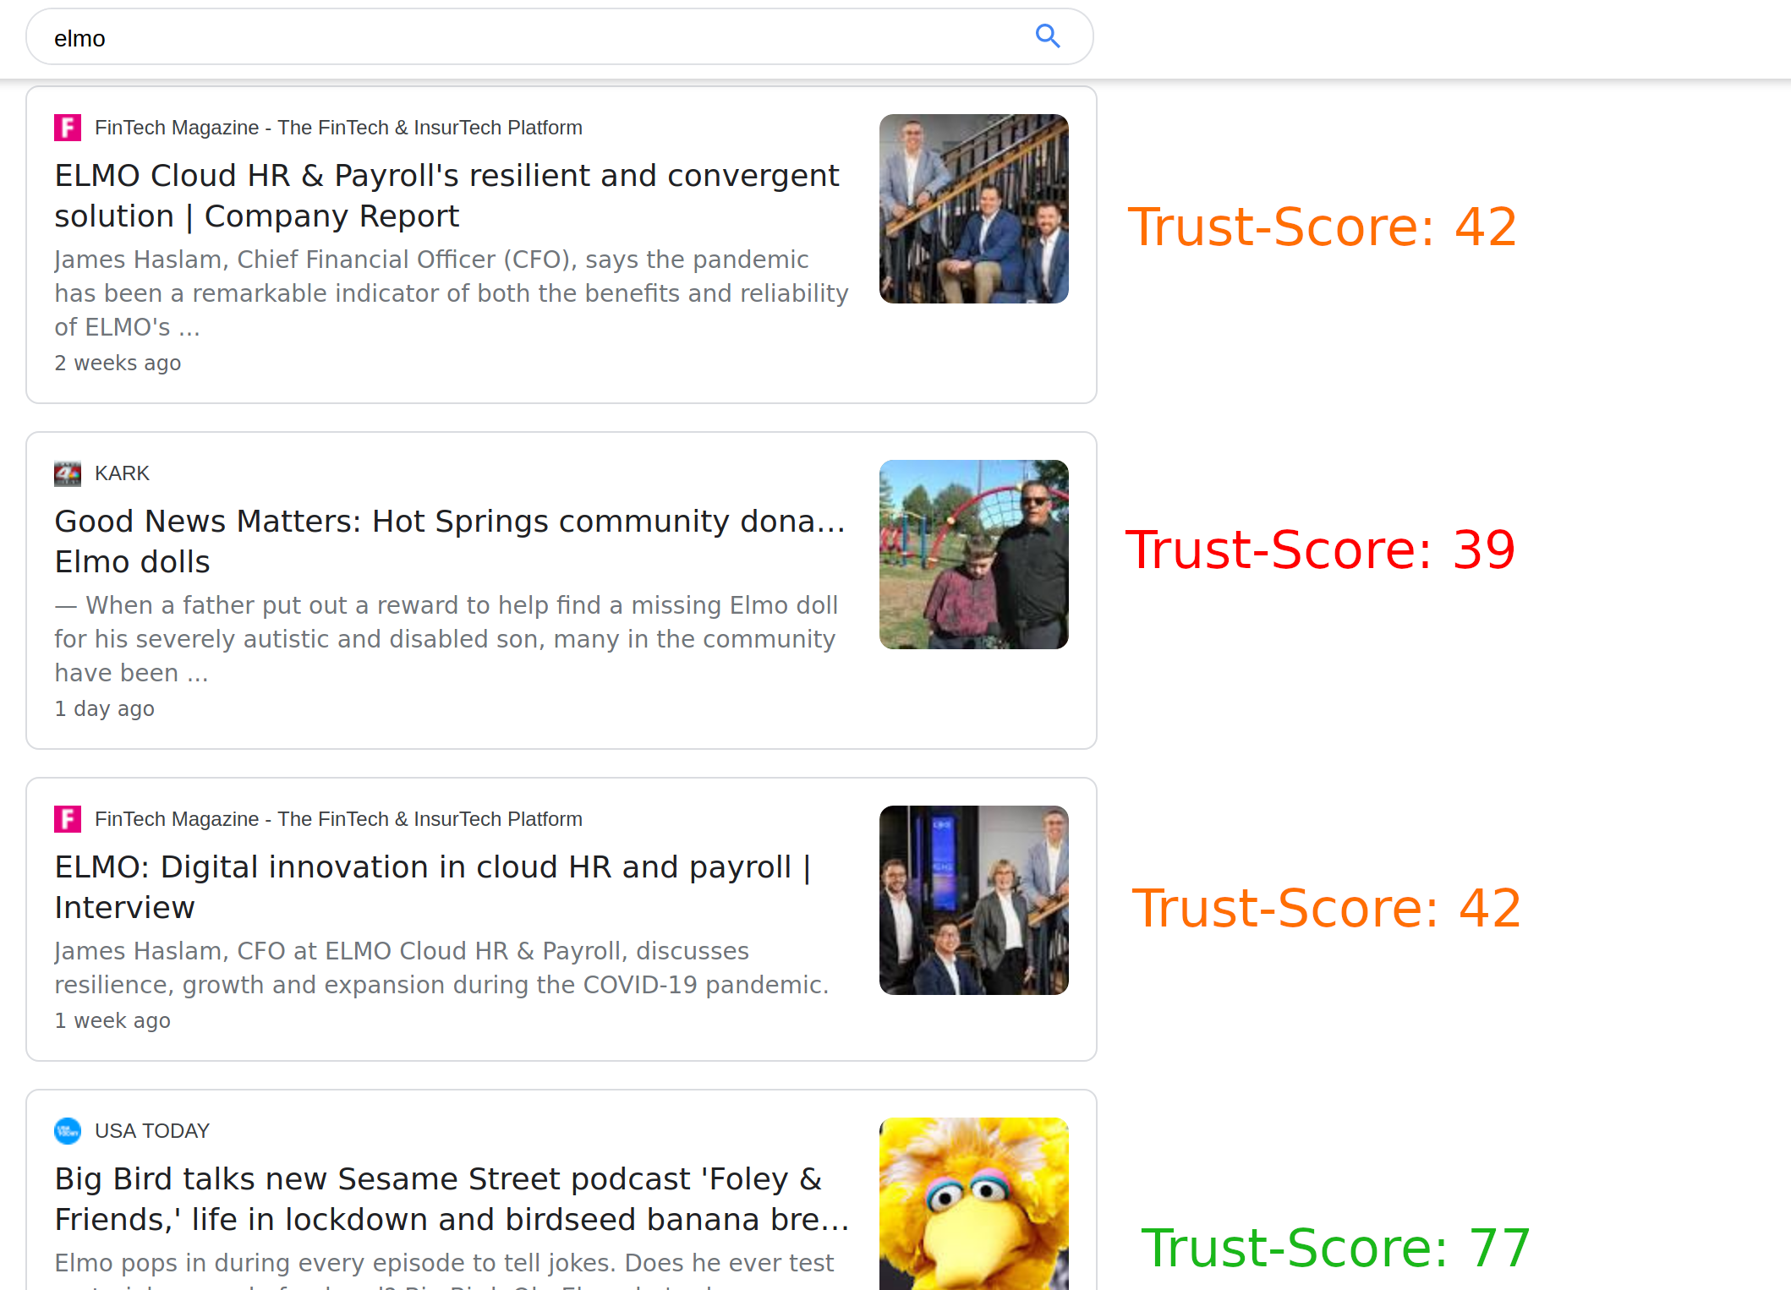
Next Steps
Finetune the algorithm and add more factors to make the article ranking more accurate (ex: check amount of ad content, utilizing a UK fact checker, etc.)
Utilize machine learning by creating a training set and applying attributes known to make an article more or less reliable
Create a front end interactive user-friendly interface to allow users to browse unbiased and trustworthy articles of their interest

